Slide 1
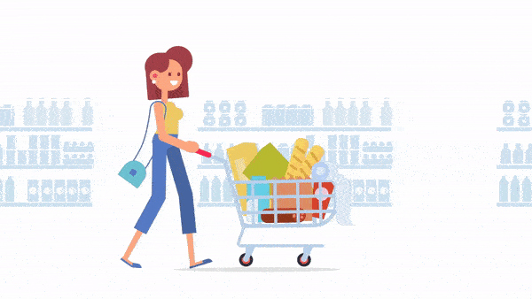
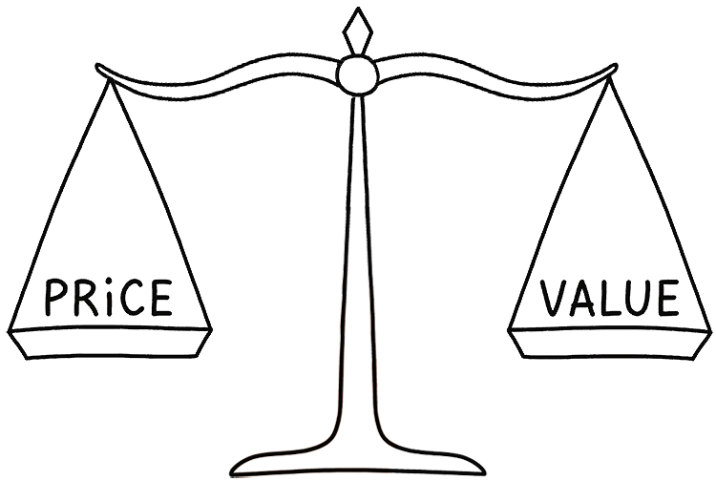
Product management and Pricing:
Presentation by
Dr.Basavaraj S.K

Slide 2
Discussion Points
Importance and primary objective of product management,
product levels,
product hierarchy,
Classification of products,
product mix,
product mix strategies,
Managing Product Life Cycle.
New Product Development,
packing as a marketing tool,
Role of labeling in packing.
Concept of Branding,
Brand Equity, branding strategies, selecting logo, brand extension- effects.
Introducing to pricing,
Significance of pricing,
factor influencing pricing (Internal factor and External factor),
objectives,
Pricing Strategies-Value based, Cost based, Market based, Competitor based, Pricing Procedure.

Slide 3
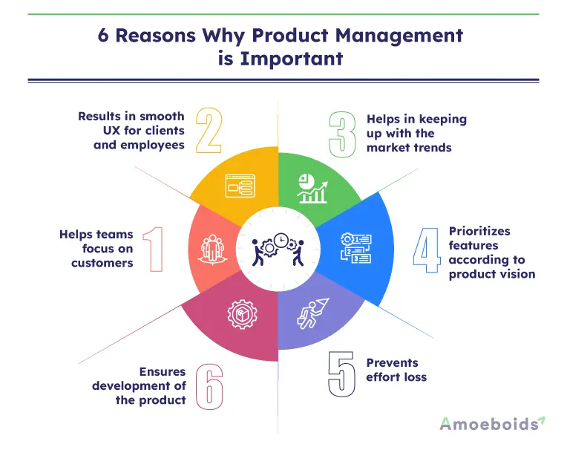

Slide 4
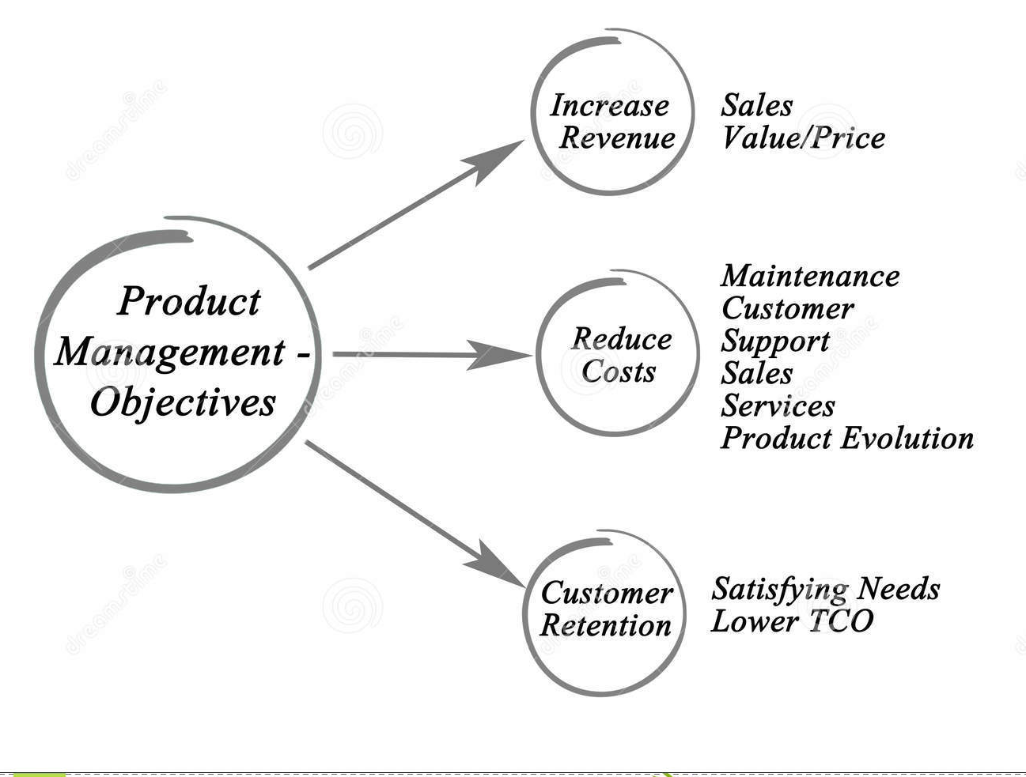

Slide 5
Product
  A product can be anything that can be offered to the market to satisfy a want or a need.
  A bundle of attributes, offering for use/consumption by the final customer.
  A bundle of utilities that has ability to satisfy needs and offord to customer for sale.

Slide 6
Levels of a Product
  5 basic levels
  Each level adds more customer value
Core Benefit
Basic/ Generic Product
Expected Product
Augumented Product
Potential Product

Slide 7
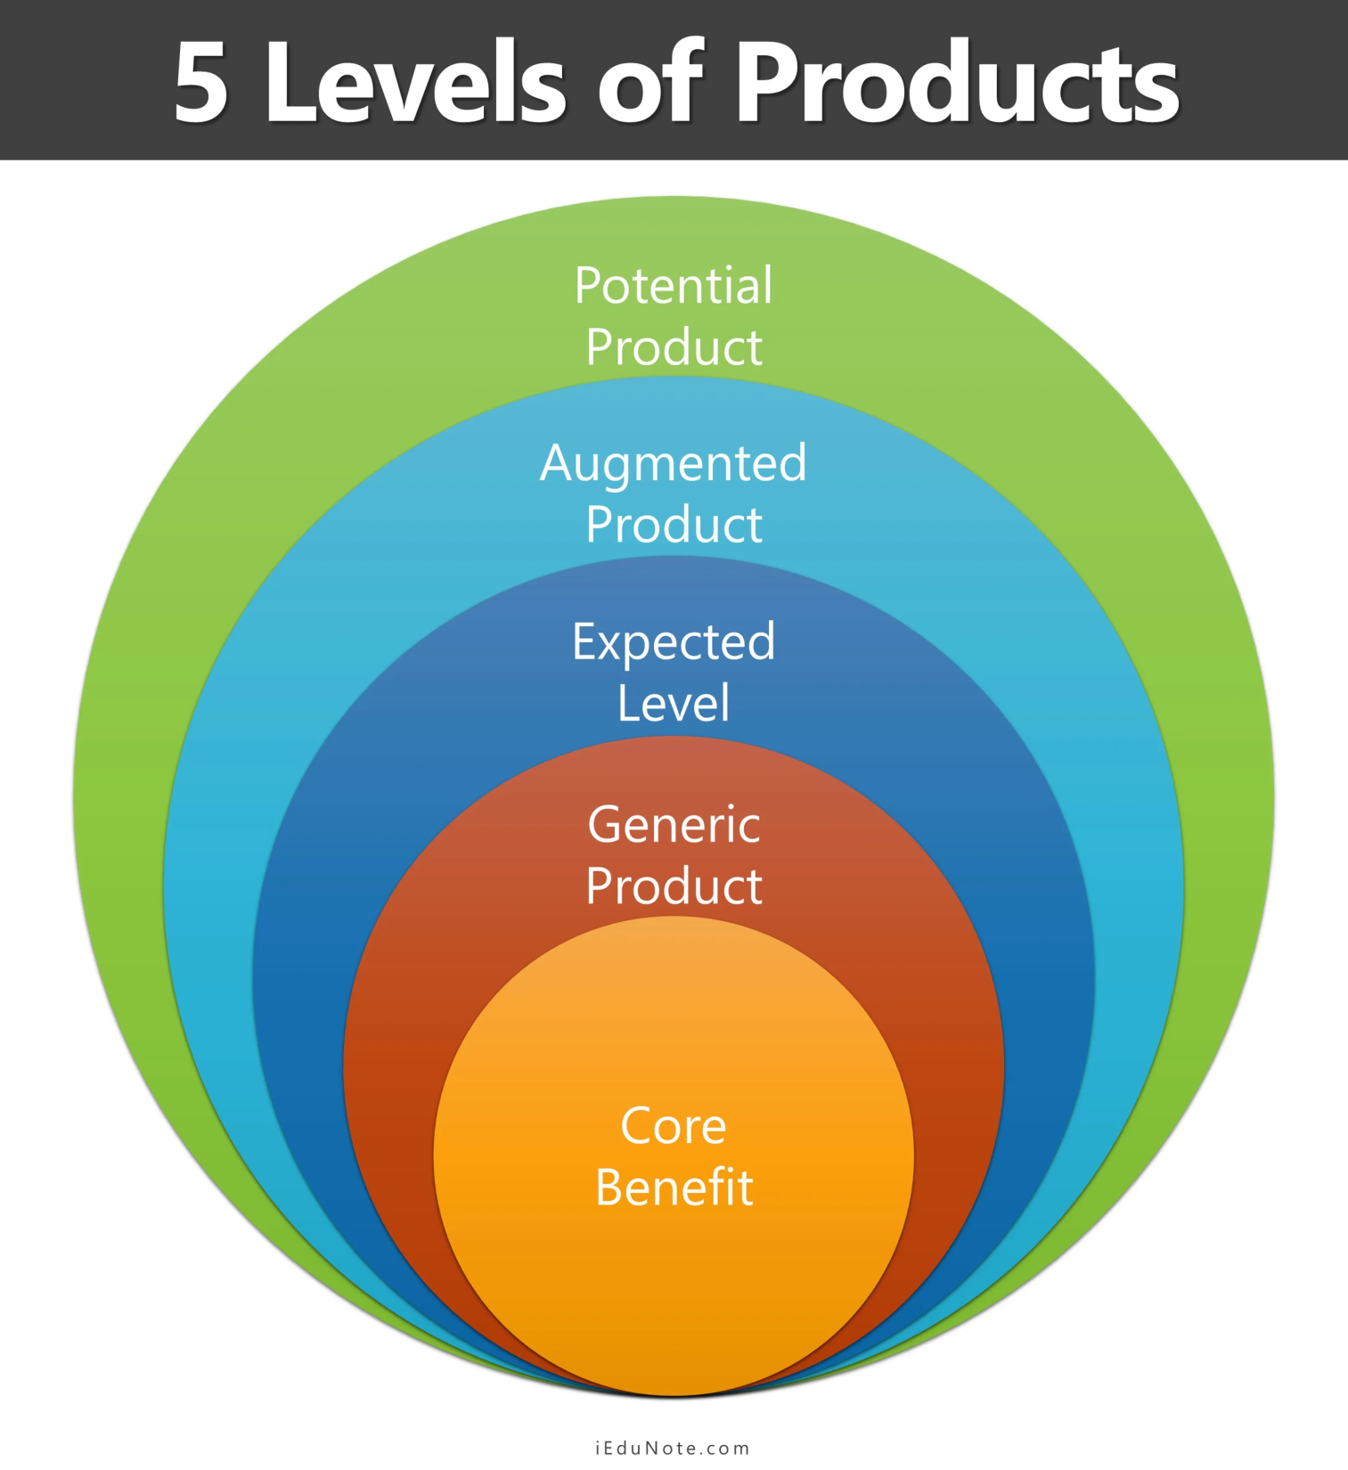

Slide 8
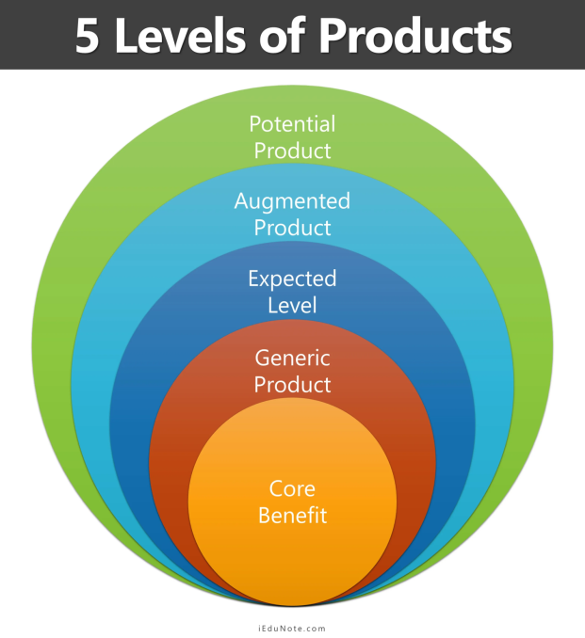
Core product
- Indicate core benefit or service
- Explains what the buyer really buys
- Basic step in designing products
- Defines problem solving benefits/ services that consumers seek
- Standardization of technology does not lead to much of difference from competing firms

Slide 9

Basic Product
  At this level, the core benefit is turned into a basic product.
  Basic step in designing products
  Unbranded, plainly packaged, less expensive

Slide 10
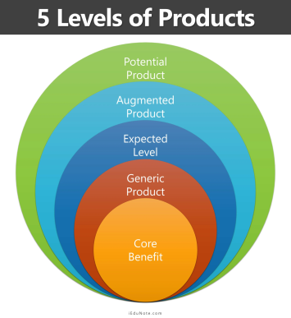
Expected product
  Expected/ Formal/ Tangible Product
- Represents Basic Requirements, A Customer Finds Essential To Buy A Product
- Attributes & Conditiones Required By The Customers – Identified-built Into Products
- Includes Brand Name, Features, Design, Packaging, Quality Level, Styling, Styling, Attributes, Instructions Manual
- As Interfirm Rivalry Intensifies, Differentiation On Basis Of Formal Product Ceases (Ceiling Fans)
- Marketer Searches For A Possible Differentiation
E.G. Sony Camcorder ( Name, Parts, Styling, Features, Packaging – Deliver Core Benefit- Convenient, High Quality Way To Capture Important Moments)

Slide 11
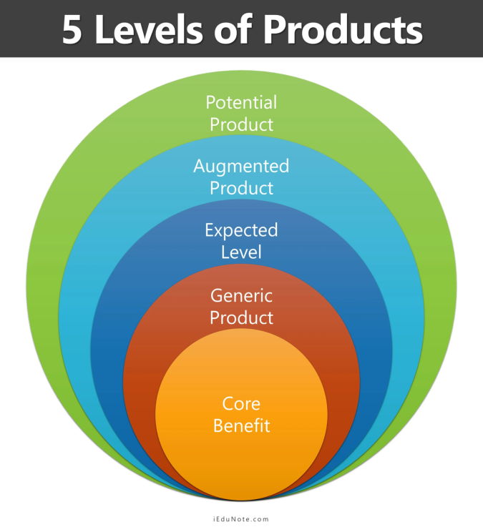
Augmented product
  Product augmentation leads the marketer to look at the user’s total consumption system.
  Attributes extended beyond customer expectations, includes
  After sales services
  Delivery points & systems
  Installation ( bulky products)
  Customer education & training
  Customer complaint management
  Payment options (high end products)
  Replacement/return policy
  Guarantees/ warranties
  Prestige, style and fashion of owning the product.

Slide 12
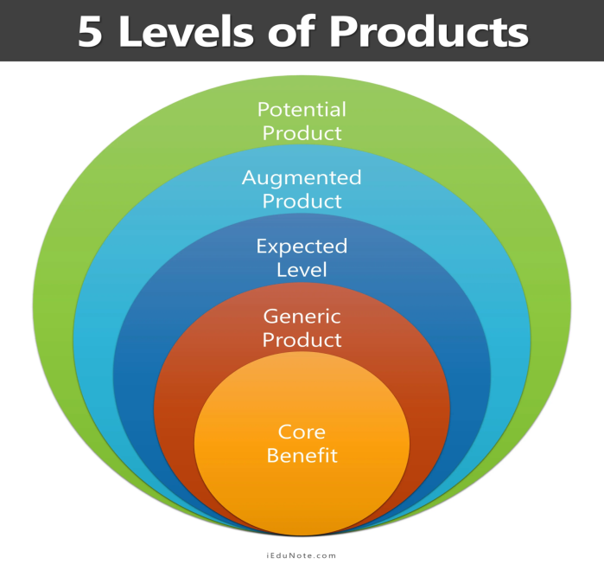
Potential
  Potential/Future product
Includes all possible improvements under given Technological, Economical, Competitive Conditions
- Helps to attract & retain customers
- Driving Force- To Retain Competitive Advantage.

Slide 13
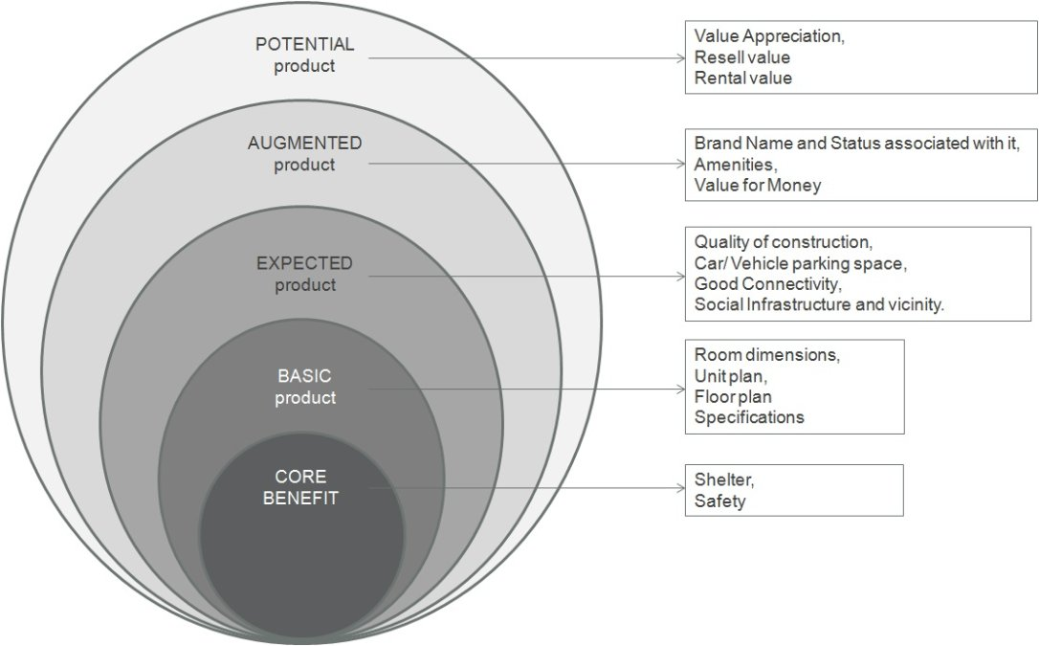
Product levels in buying a residentail building

Slide 14
Types of Products:
Products
Based on Nature
Based on Consumers Intentions
Based on Social Benefit
Goods
Service
Idea
Experience
Events
Persons
Places
Organization
Information
Consumer Products
Industrial Product
Pleasing products.
Deficient Products
Salutary Products
Desirable Product
1.Convinience Product
2. Shopping Product
3. Specialty Product
4. Unsought Products
1. Raw material
2.CapitalEquipment
3. Accessories
4.Component parts
5.Process material supplies
6. Industrial services

Slide 15
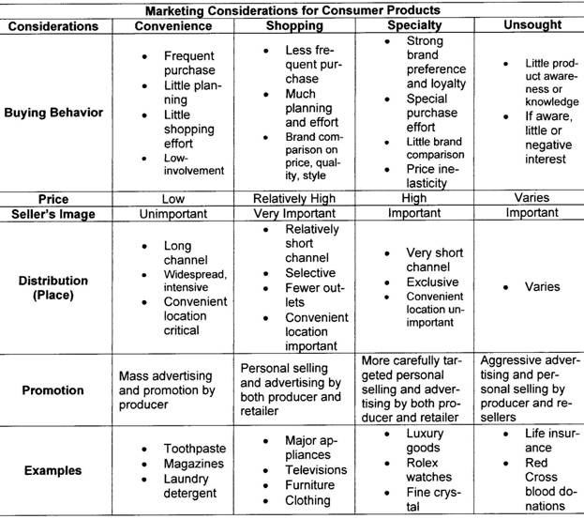
Types of Consumer Products

Slide 16
2. Industrial Products:
- Distinguished from consumer products on the basis of usage
e.g. A lawn mower.
  Materials & parts
- Farm products, (wheat, cotton, livestock, fruits, vegetables)
- Natural products (fish, lumber, crude oils, iron ore)
ii. Manufactured materials & parts:
- component materials (iron yarn, cement, wires)
- Component parts ( small motors, tires, castings)

Slide 17
b. Capital items
- Aid in buyer’s production or operations
i. Installations:
- Major purchases (factories, offices)
- fixed equipment ( generators, elevators,
computer systems)
ii. Accessory equipments:
- Portable factory equipments and tools (hand
tools, lift trucks)
- Office equipments ( computers, fax machines, desks)

Slide 18
c. Supplies and Services:
- Are convenience products
i. Supplies
- Operating supplies (Lubricants, coal,
paper, pencil)
- Repair and maintenance (paint, nails,
brooms)
ii. Services
- Maintenance and repair services (window clearing, computer repair)
- Business advisory services ( legal, management, consulting, advertising)

Slide 19
Based on Social Benefit products can be classified as:
Pleasing products.
Deficient Products
Salutary Products
Desirable Product

Slide 20
1. Pleasing Products:
These products have short run consumer benefits but high degree of immediate gratification. These products may hurt consumers in the long run.
Example: - Cigarettes, junk food etc.

Slide 21
2. Deficient Products
There are the products which are not of utmost quality. The companies produce these products intentionally with a view to induce consumers to purchase the goods and services regularly.
Examples: Low quality sleeping pills, Low quality pesticides, Low quality medicines etc

Slide 22
3. Salutary Products
Salutary products are the products that have low appeal but may benefit consumers in the long run. These products do not provide immediate satisfaction hence the degree of overall market acceptance of these products is limited.
Examples: Seat belts, Air bags etc.

Slide 23
4 Desirable Products:
This is a concept of societal marketing which says that the products should not just be made for profit, but for the benefit of consumers and the society as a whole. It propagates that a good product should have a two-fold aim:
1. To satisfy the consumers immediate requirements and provide satisfaction
2. To take care of the benefit of society in the long run
Example: Body shop products which can protect cancer, skin psoriasis etc./ Mouth fresheners / Hygiene products etc.

Slide 24
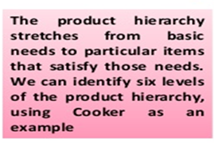
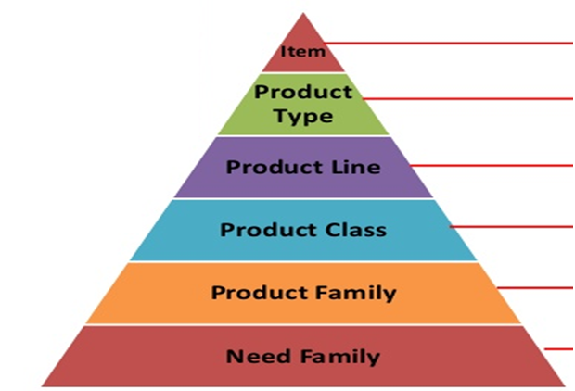
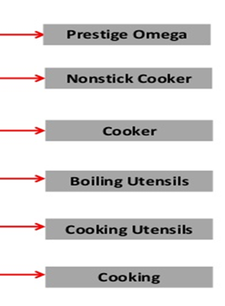
Product Hierarchy

Slide 25
Importance of product hierarchy
Helps marketers identify competition at different levels
Aids in product positioning and branding
Supports strategic decisions on diversification and line extensions
Useful for consumer behavior analysis

Slide 26
Exercise:
Place the Bru Coffee in Product Hierarchy

Slide 27
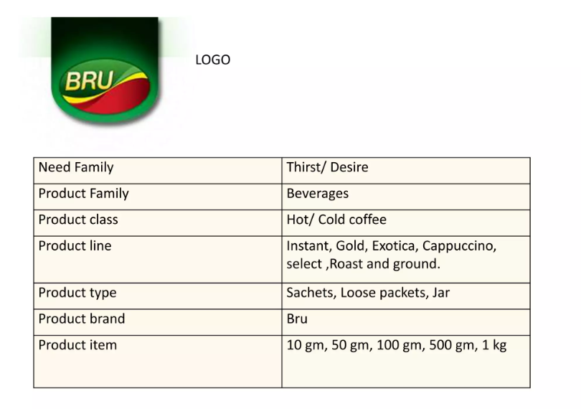

Slide 28
What is product-mix ?
Set of all product offered for sale by a company.
It consist of various product line.
Any company’s product mix has four dimension :
1. Width
        2. Length
        3. Depth
        4. Consistency

Slide 29
Width : Number of different product lines
carries by the company.
Length : Total number of items in the
product mix of the company.
Depth : Assortment of size, colour and
models offered in each item of a
product line.
Consistency : It refers to the relationship of
various product line either in their end use, production requirement, distribution
channel or other way.

Slide 30
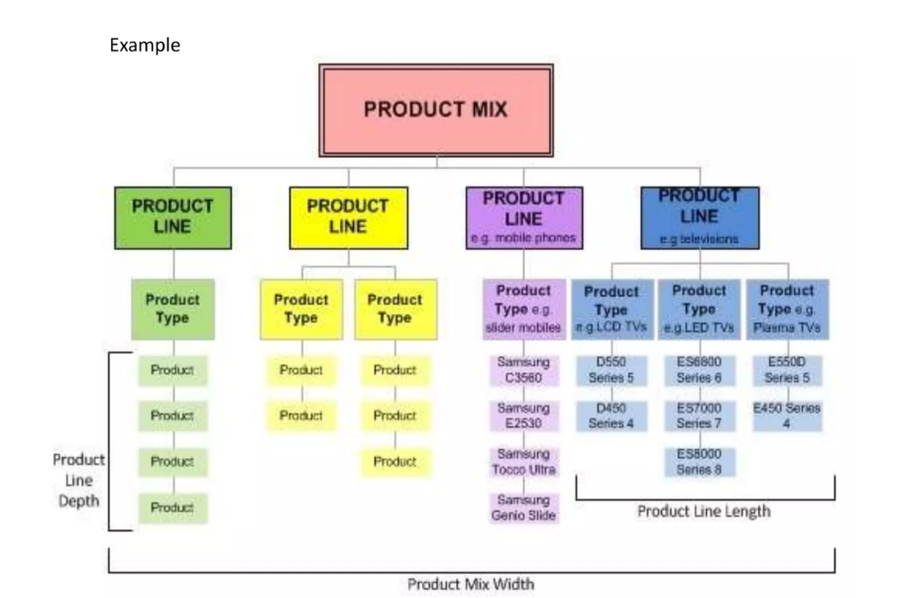

Slide 31
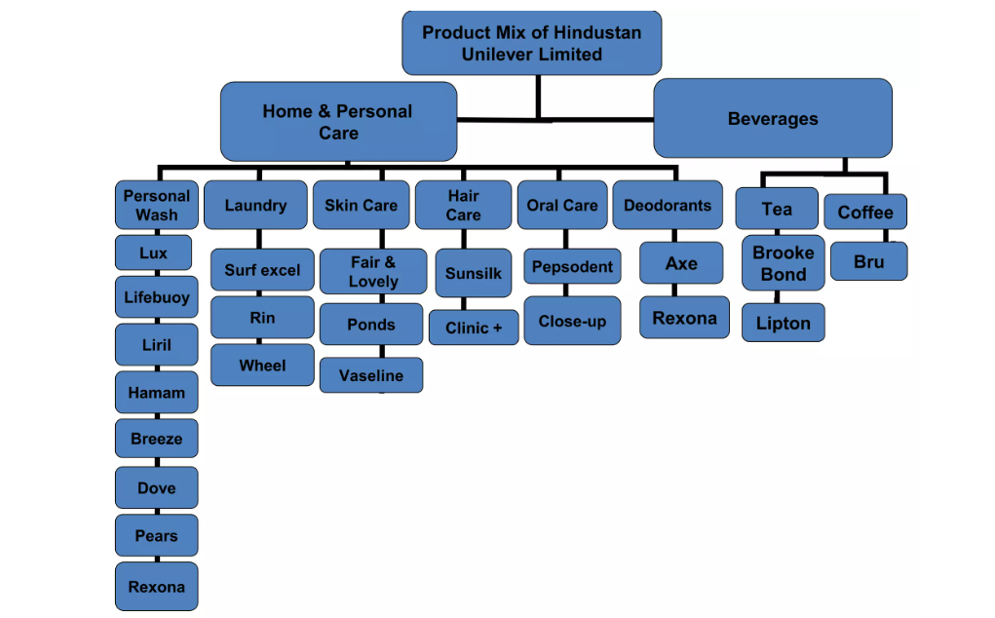

Slide 32
PRODUCT-MIX DESISIONS
A. PRODUCT LINE ANALYSIS
Taking decision regarding whether adding new product line or not, lengthen the existing product line or not, analysis of product line is useful.
B. MARKET PROFILE ANALYSIS
Product line manager must review the position of its company’s product line against competitors lines. Product map is used to show the position of their items against competitors items.

Slide 33
Product Mix Strategies
Product Line expansion/ Contraction.
Product Modification.
Product Elimination

Slide 34
PRODUCT LIFE CYCLE

Slide 35
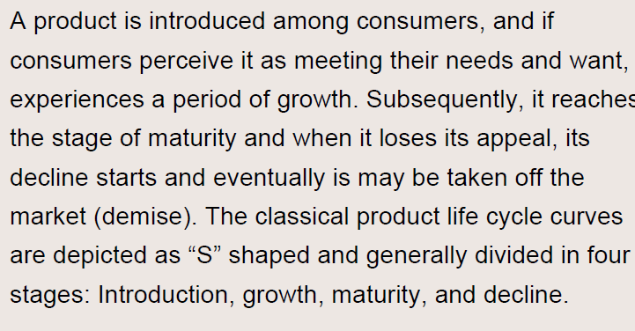
Product Life Cycle
Introduction:

Slide 36
Stages of Product Life Cycle. (PLC)
Introduction Stage
Growth Stage
Maturity Stage
Decline Stage

Slide 37
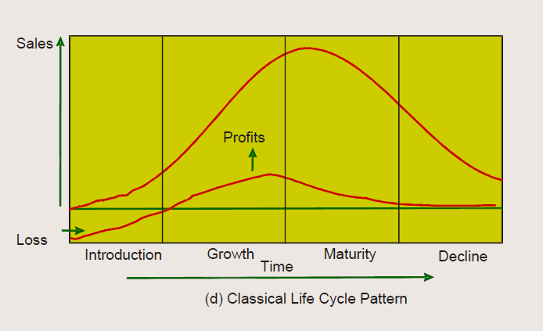
Product Life Cycle Curve:

Slide 38
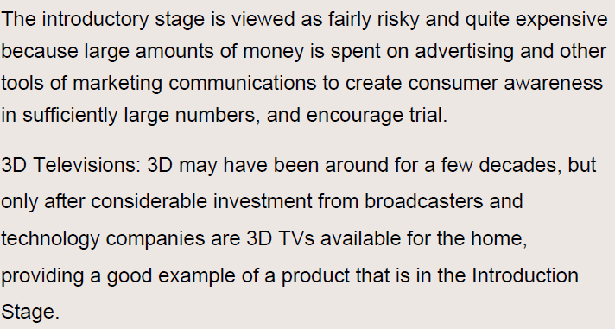
Introduction Stage

Slide 39
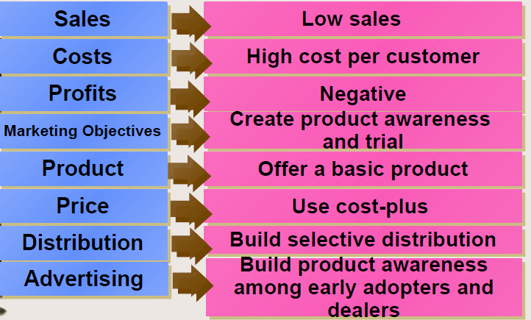
Introduction Stage of PLC

Slide 40
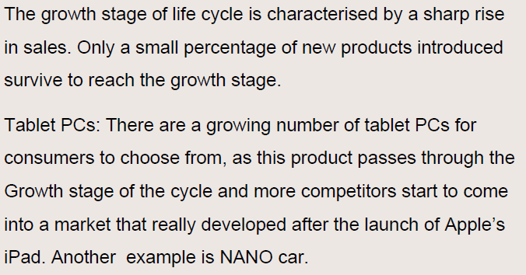
Growth Stage

Slide 41
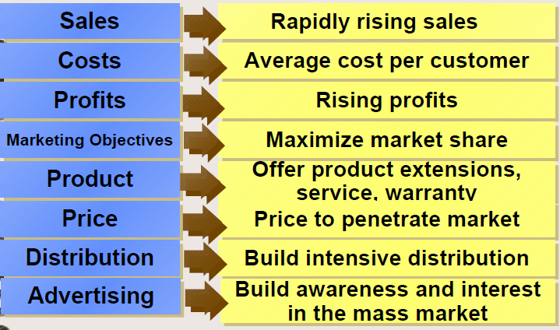
Growth Stage

Slide 42
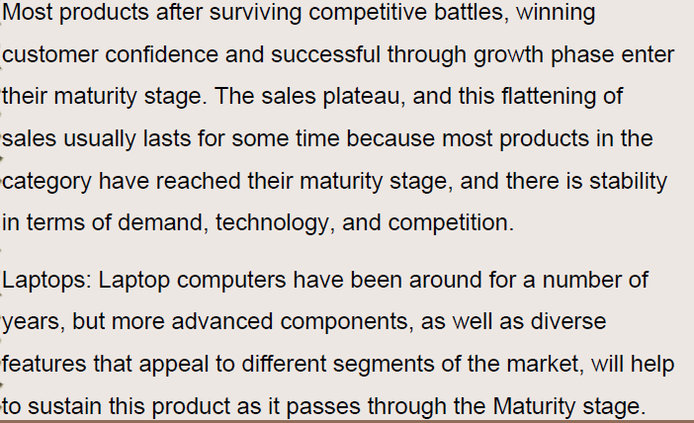
Maturity Stage

Slide 43
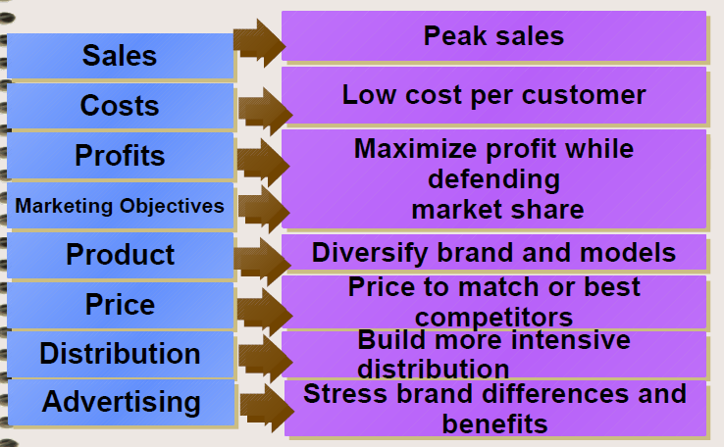
Maturity Stage

Slide 44
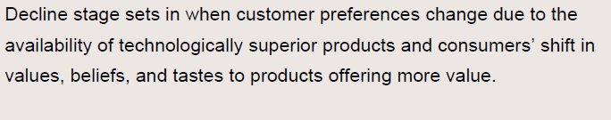
Decline Stage

Slide 45
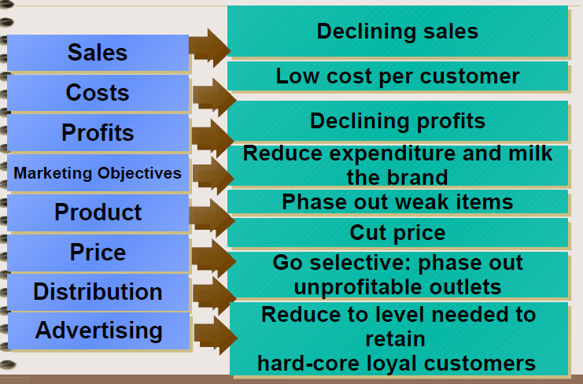
Decline Stage

Slide 46
NEW PRODUCT DEVELOPMENT

Slide 47
What is new product
According to Stanton:
A new product is one which is really innovative and significantly different from existing products that are new to the company.

Slide 48
Importance of New Product Development
Meeting Changes in Consumer Demand
Making high profits.
Combating Environmental Threats.
Reduce competition.
Use research and development

Slide 49
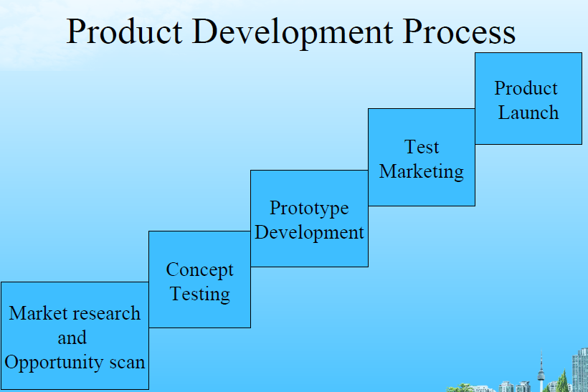

Slide 50
Packaging and Labeling

Slide 51
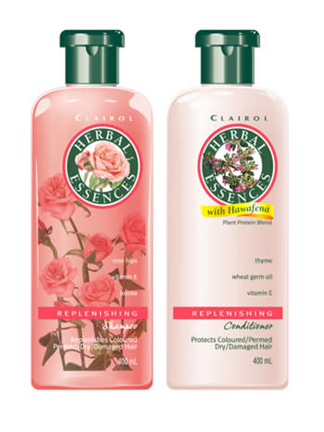
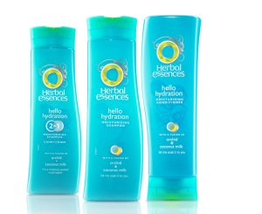
Packaging
The package = physical container or wrapping for a product
It is an integral part of product planning and promotion
  10% of the retail price is spent on developing, designing, and producing just the package
Companies sometimes change packaging to update their image and reach a new market

Slide 52
Functions of Packaging
1. Promoting and Selling the Product
2. Defining Product Identity
3. Providing Information
4. Expressing Customer Needs
5. Ensure Safe Use
6. Protecting the Product
The Keys to Product Packaging

Slide 53
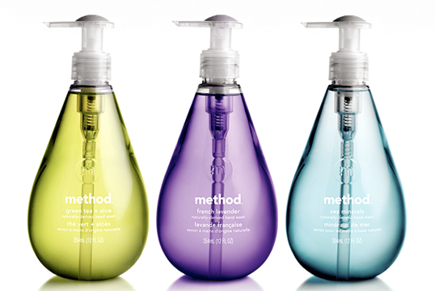
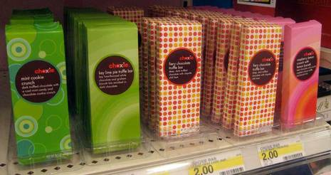
1. Promoting and Selling the Product
  Attractive, colorful, and visually appealing packages have promotional value
  A well designed package is a powerful selling device because it helps the product stand out from its competitors

Slide 54
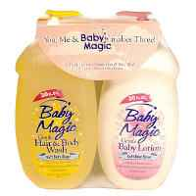
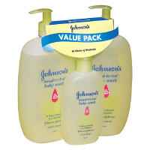
1. Promoting and Selling the Product
  Mixed Bundling – packaging different products or services together
    Usually the bundle price is cheaper than buying them individually
  Price Bundling – two or more similar products are placed on sale for one package price

Slide 55
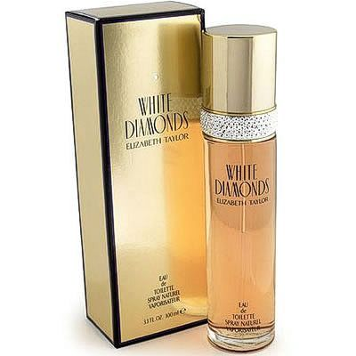
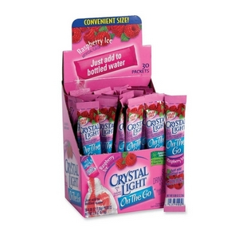
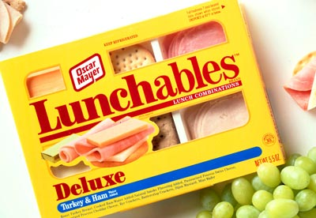
2. Defining Product Identity
  Packaging is sometimes used to promote an image such as prestige, convenience, or status
  Can be a crucial part of the marketing strategy, particularly in advertising

Slide 56
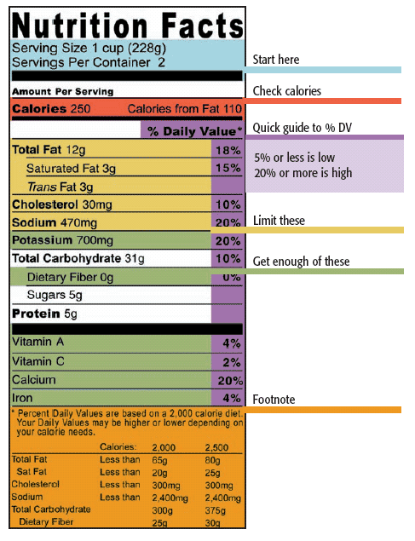
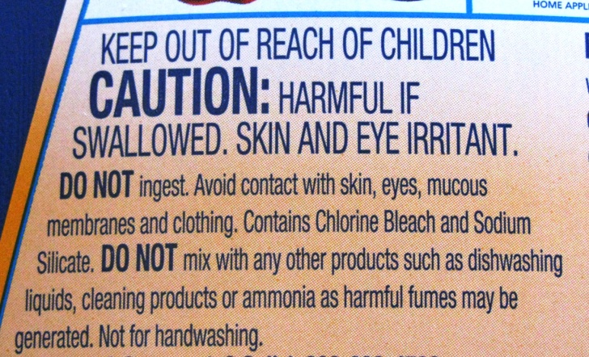
3. Providing Information
  Gives customer useful information on:
    directions for using the product
    its contents
    product guarantees
    nutritional value
    potential hazards

Slide 57
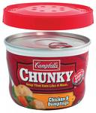
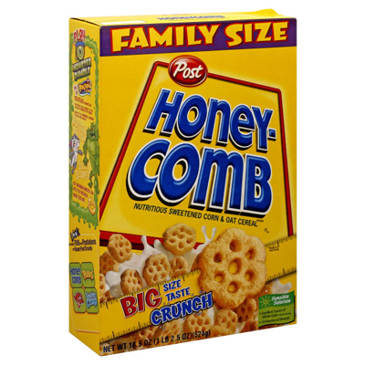
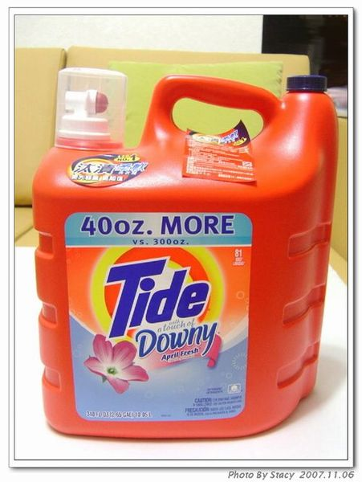
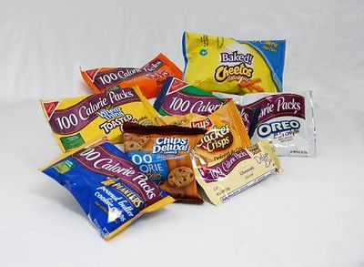
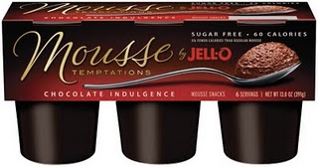
4. Expressing Customer Needs
  When designing packages, companies analyze customer lifestyles and create packaging that meets their needs for size and convenience
  Packages often come in various sizes
    Family size
    Single serving

Slide 58

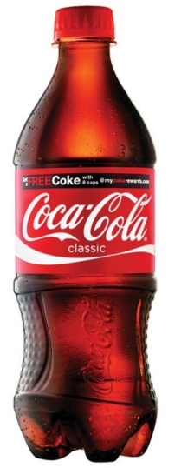
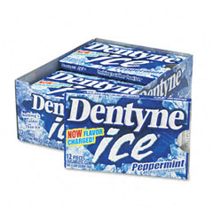

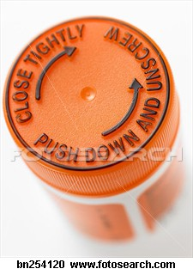
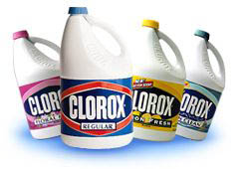
5. Ensure Safe Use
  Proper packaging helps to eliminate potential injuries or misuse of a product
    Formerly glass containers are now plastic
    Childproof caps
    Tamper resistant packages
      Blisterpacks – packages with preformed plastic molds surrounding individual items arranged on a backing

Slide 59

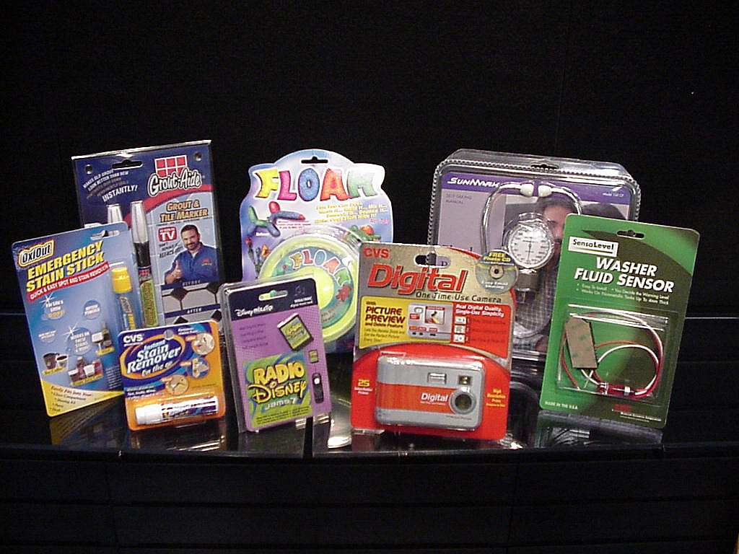
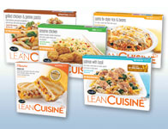
6. Protecting the Product
  Must protect during shipping, storage, and display
  Prevent or discourage from tampering
  Prevent shoplifting
  Protect against breakage and spoilage

Slide 60



Air To Spare
Do you ever get frustrated when you buy something and the package if filled with more air than product?
Air To Spare

Slide 61



Packaging TRENDS
Aseptic Packaging –technology that keeps foods fresh without refrigeration for extended periods
Usually used to package food products
  canning
  bottling

Slide 62


Packaging TRENDS
Environmental Packaging – recycled material, less plastic, and safer for the environment
Sun Chips Ditching New Bag

Slide 63



Packaging TRENDS
Cause Packaging – promote social and political causes
  May be totally unrelated to the product

Slide 64



labeling
Label – an identification tag, wrapper, seal, or imprinted message that is attached to a product or its package
Main function is to inform customers about a product’s contents and give directions for use
Protects businesses from legal liability if someone if injured while using the product

Slide 65


Three Kinds of Labels
Brand Label – gives brand name and trademark or logo
Descriptive Label – give information about product use, construction, care, performance, and other features
Grade Label – states the quality of a product

Slide 66
Pricing

Slide 67
What is pricing?
Pricing is the process whereby a business sets the price at which it will sell its products and services, and may be part of the business's marketing plan. In setting prices, the business will take into account the price at which it could acquire the goods, the manufacturing cost, the market place, competition, market condition, brand, and quality of product.

Slide 68
Significance of Pricing
Price is used as tool in positioning strategy.
Price play role in managing Product Life Cycle Stages
Price influences elasticity of demand.
Price is tool for competition in the market
Price is used as an indicator of quality.

Slide 69
Factors influencing Pricing
Internal Factors.
Organisational Factors
Marketing mix
Product differentiation
Cost of the product.
Firms objectives.
B. External Factors:
Demand
Competition
Suppliers.
Economic condition
Buyers
Government

Slide 70
Objectives of Pricing
Profit maximisation
Curbing competition
Capturing the new market.
Welfare of the firm
Mentain price stability.
Margin to middlemen.
Achieving target return.

Slide 71

Pricing Strategies

Slide 72

New Product Pricing Strategy
Skimming Pricing is a product pricing strategy by which a firm charges the highest initial price that customers will pay. As the demand of the first customers is satisfied, the firm lowers the price to attract another, more price-sensitive segment.
Penetration pricing is a pricing strategy where the price of a product is initially set low to rapidly reach a wide fraction of the market and initiate word of mouth. The strategy works on the expectation that customers will switch to the new brand because of the lower price.

Slide 73
Differential Pricing Strategy:
Negotiated Pricing: The price decided by the mutual discussion between buyer and seller.
Secondary market Pricing: The price decided by the second owner of the product as per his convenience understanding the buyer expectations.
Periodic discounting: It is a strategy whereby a seller chooses to vary the price of a good in an easy-to-predict pattern over time, done in order to maximize profits by selling to each potential buyer at a price closest to the buyer's reservation price.
Random discounting, also called variable merchandise pricing, is a strategy whereby a seller maintains a somewhat high price most of the time, discounting it significantly in a manner that is not easy to predict.

Slide 74
Psychological Pricing Strategies.
Psychological pricing (also price ending, charm pricing) is a pricing/marketing strategy based on the theory that certain prices have a psychological impact.
Odd Pricing: A little less than a round number, e.g. Rs.19.99 or Rs. 99.
Multiple Unit Pricing: Offering a lower price per unit for the purchase of two or more products of the same type when bought together than when units are bought singly.
Reference Pricing: Reference pricing refers to how much consumers expect to pay for a good in relation to other competitors and the previously advertised price. It is price fixed below the price of competitor in relation to the a specific product.
Bundle Pricing: In a bundle pricing, companies sell a package or set of goods or services for a lower price than they would charge if the customer bought all of them separately. Common examples include option packages on new cars, value meals at restaurants and cable TV channel plans.
Every day low price: Everyday low price is a pricing strategy offering consumers a low price without having to wait for sale price events or comparison shopping.
Customary Pricing: A method of determining the price for a good or service based on the perceived expectations of customers. Eg. Hospital charging bills for different types of customers.

Slide 75
Product Line Pricing Strategy:
It is the process that retailers use to separate goods into various cost categories creating different quality levels in the minds of their customers. Product line pricing is more effective when there are ample price gaps between each category so that the consumer is well informed of the quality differentials.
Captive Product Pricing: Captive products are strategically used to maximize revenue. ... Low price are offered for the core product, but high prices are placed on captive products. This attracts customers to the core product with a low price but allows sellers to make a profit off the captive products, which are necessary to use the product. Eg. Ink price is high where as Printer price is low:
Premium Pricing: Premium pricing (also called image pricing or prestige pricing) the practice of keeping the price of a product or service artificially high in order to encourage favorable perceptions among buyers, based solely on the price. ( Parker Pen. Nike Shoes etc).
Price lining : It is also referred to as product line pricing, is a marketing process wherein products or services within a specific group are set at different price points. The higher the price, the higher the perceived quality to the consumer. ( Samsung mobile ranges)

Slide 76
Promotional Pricing Strategy:
1.Price Leader: Price leadership is when a firm that is the leader in its sector determines the priceof goods or services. This approach can leave the leader's rivals with little choice but to follow its lead and match these prices if they are to hold onto their market share. ( Eg. Cocacola for soft drinks).
2. Special Event Pricing: To increase sales volume, many organisations coordinate price with advertising or sales promotion for seasonal or special situations (Sales). Special event pricing involves advertised sales or price cutting that is linked to a holiday, season, or event.
3. Comparison Discounting Price: Providing the discounting price comparing with previous price.

Slide 77
Pricing Procedure:
Following 8 Steps are involved in Pricing procedure:
Market Segmentation.
Demand Estimation.
Market share.
Deciding on Marketing Mix.
Cost estimation
Deciding Pricing Policies.
Pricing strategies.
Price structure:
Find the notes:
Notes:
(i) Market Segmentation:
In market segments, marketers will have firm decisions on:
(a) The type of products to be produced or sold.
(b) The kind of service to be rendered.
(c) The costs of operations to be estimated.
(ii) Estimate Demand:
Marketers will estimate total demand for the product based on sales forecast, channel opinions and degree of competition in the market. Prices of comparable rival products can guide us in pricing our products. We can determine market potential by trying different prices in different markets.
(iii) The Market Share:
Marketers will choose a brand image and the desired market share on the basis of competitive reaction. Market planners must know exactly what his rivals are charging. Level of competitive pricing enables the firm to price above, below or at par and such a decision is easier in many cases.
Higher initial price may be preferred, in case of smaller market share is anticipated, whereas, in the expectation of a much larger market share for the brand, marketer will have to prefer relatively lower price. Proper pricing strategy is evolved to reach the expected market share either through skimming price or through penetration price or through a compromise, i.e., fair trading or fair price- to cover cost of goods, operating expenses and normal profit margin.
(iv) The Marketing Mix:
The overall marketing strategy is based on an integrated approach to all the elements of marketing mix.
It covers:
(a) Product-market strategy
(b) Promotion strategy
(c) Pricing Strategy
(d) Distribution Strategy
Marketers will have to assign an appropriate role to price as an element of marketing- mix. Promotional strategy will affect pricing decisions.
The design of marketing mix can indicate the role to be played by pricing in relation to promotion and distribution policies. Price is critical strategic element of the marketing mix as it influences the quality perception and enables product or brand positioning. Price is also a good tactical variable. Changes in price can be made much faster than in any other variable of marketing mix. Hence, price has a good tactical value.
(v) Estimate of Costs:
Straight, cost-plus pricing is not desirable always as it is not sensitive to demand. Marketing must take into account all relevant costs as well as price elasticity of demand.
(vi) Pricing Policies:
Pricing policies are guidelines to carry out pricing strategy. Pricing policy may be fixed or flexible. Pricing policies must change and adopt themselves with the changing objectives and changing environment.
(vii) Pricing Strategies:
Strategy is a plan of action to adjust with changing condition of the– market place. New and unanticipated developments such as price cut by rivals, government regulations, economic recession, changes in consumer demand etc. may take place, and then changes all for special attention and relevant adjustments in the pricing policies and producers.
(viii) The Price Structure:
Developing the price structure on the basis of pricing policies and strategies is the final step in price determination prices. The price structure will now define the selling prices for all products and permissible discounts and allowances to be given to distributor’s co-dealers as well as various types of buyers.

Slide 78
Thank You

